Slide 1
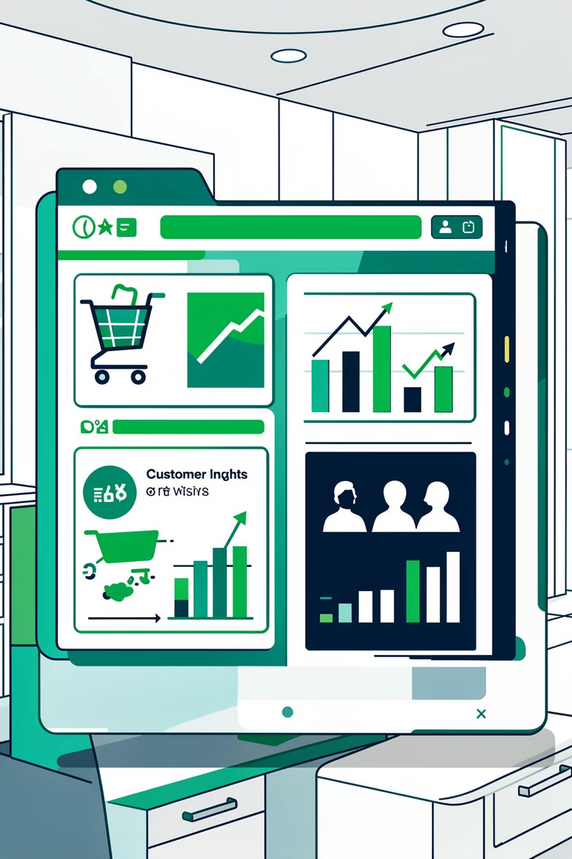
Customer Shopping Behavior Analysis
Uncovering insights from 3,900 purchases to guide strategic business decisions

Slide 2

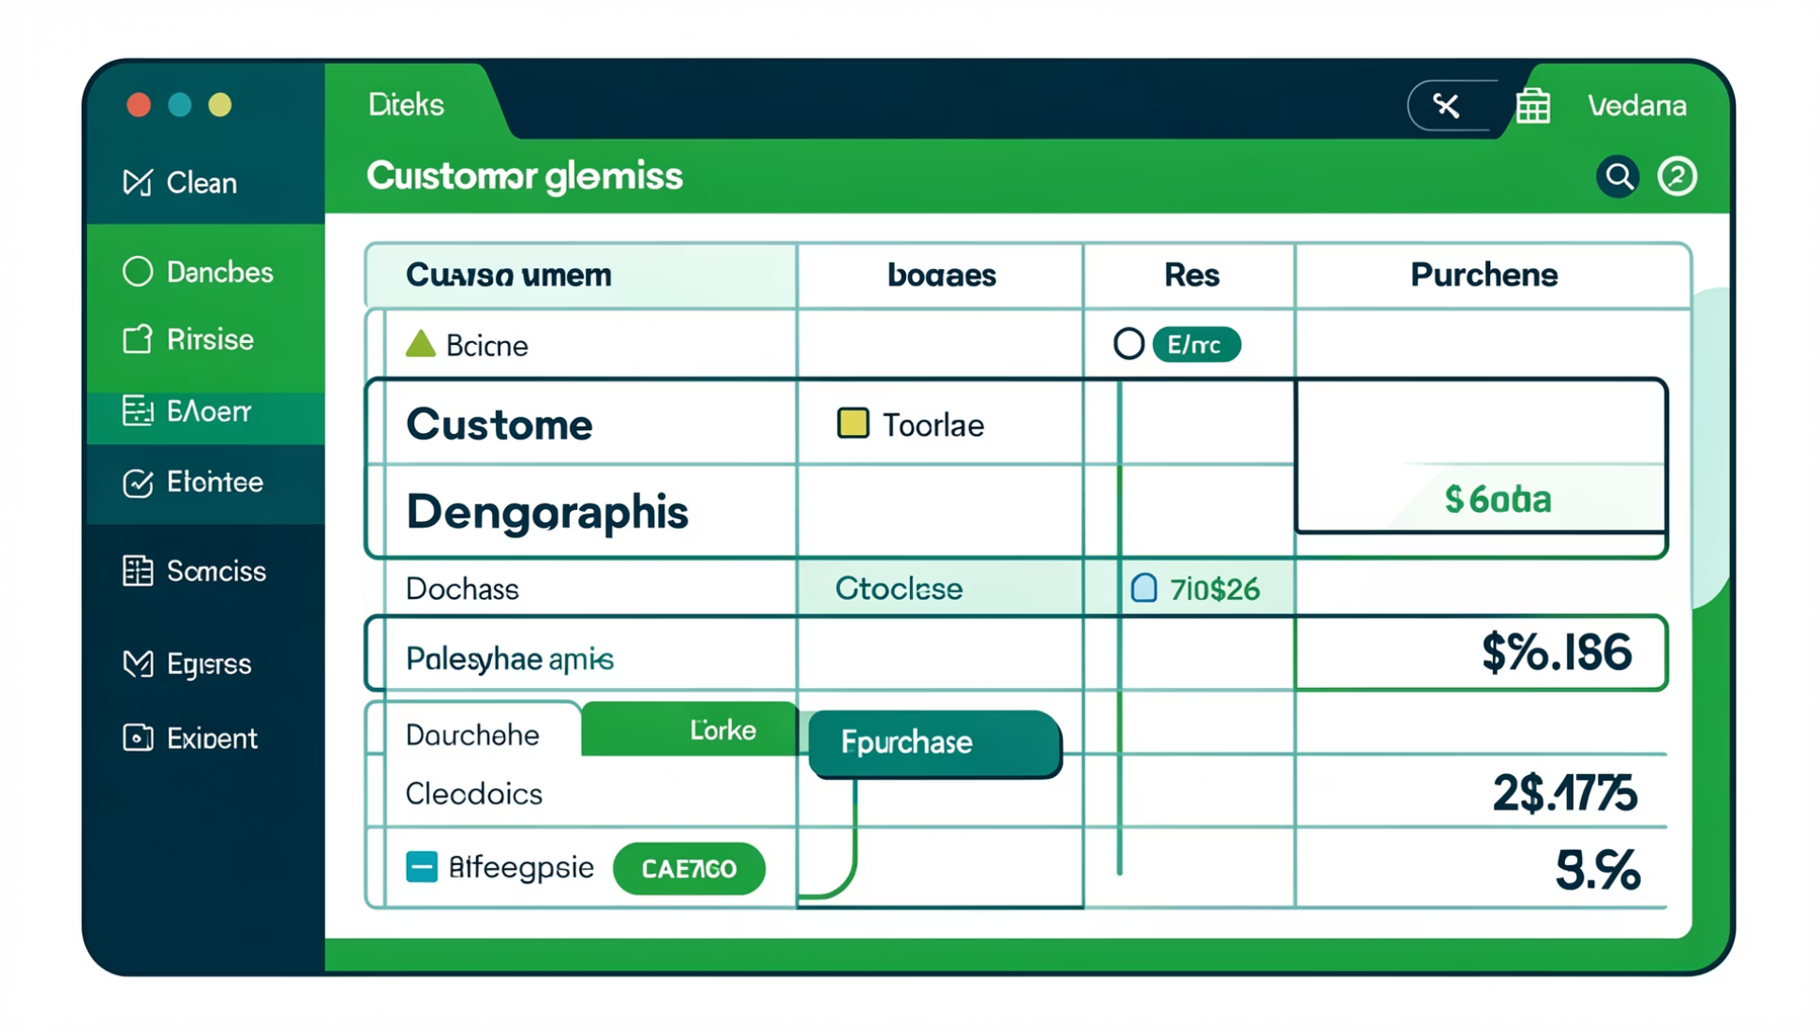
DATASET OVERVIEW
The Foundation
3.9K
18
50
Total Purchases
Data Points
Locations
Transactions analyzed
Features per transaction
Geographic coverage
Key Data Categories
Customer demographics: Age, Gender, Location
Purchase details: Items, Categories, Amount, Season
Shopping behavior: Discounts, Reviews, Frequency
Subscription status and shipping preferences

Slide 3

PYTHON ANALYSIS
Data Preparation & Cleaning
01
02
Data Loading
Missing Data
Imported dataset using pandas, explored structure with .info() and .describe()
Imputed 37 missing Review Ratings using median by category
03
04
Feature Engineering
Database Integration
Created age_group bins and purchase_frequency_days columns
Connected to PostgreSQL for advanced SQL analysis

Slide 4
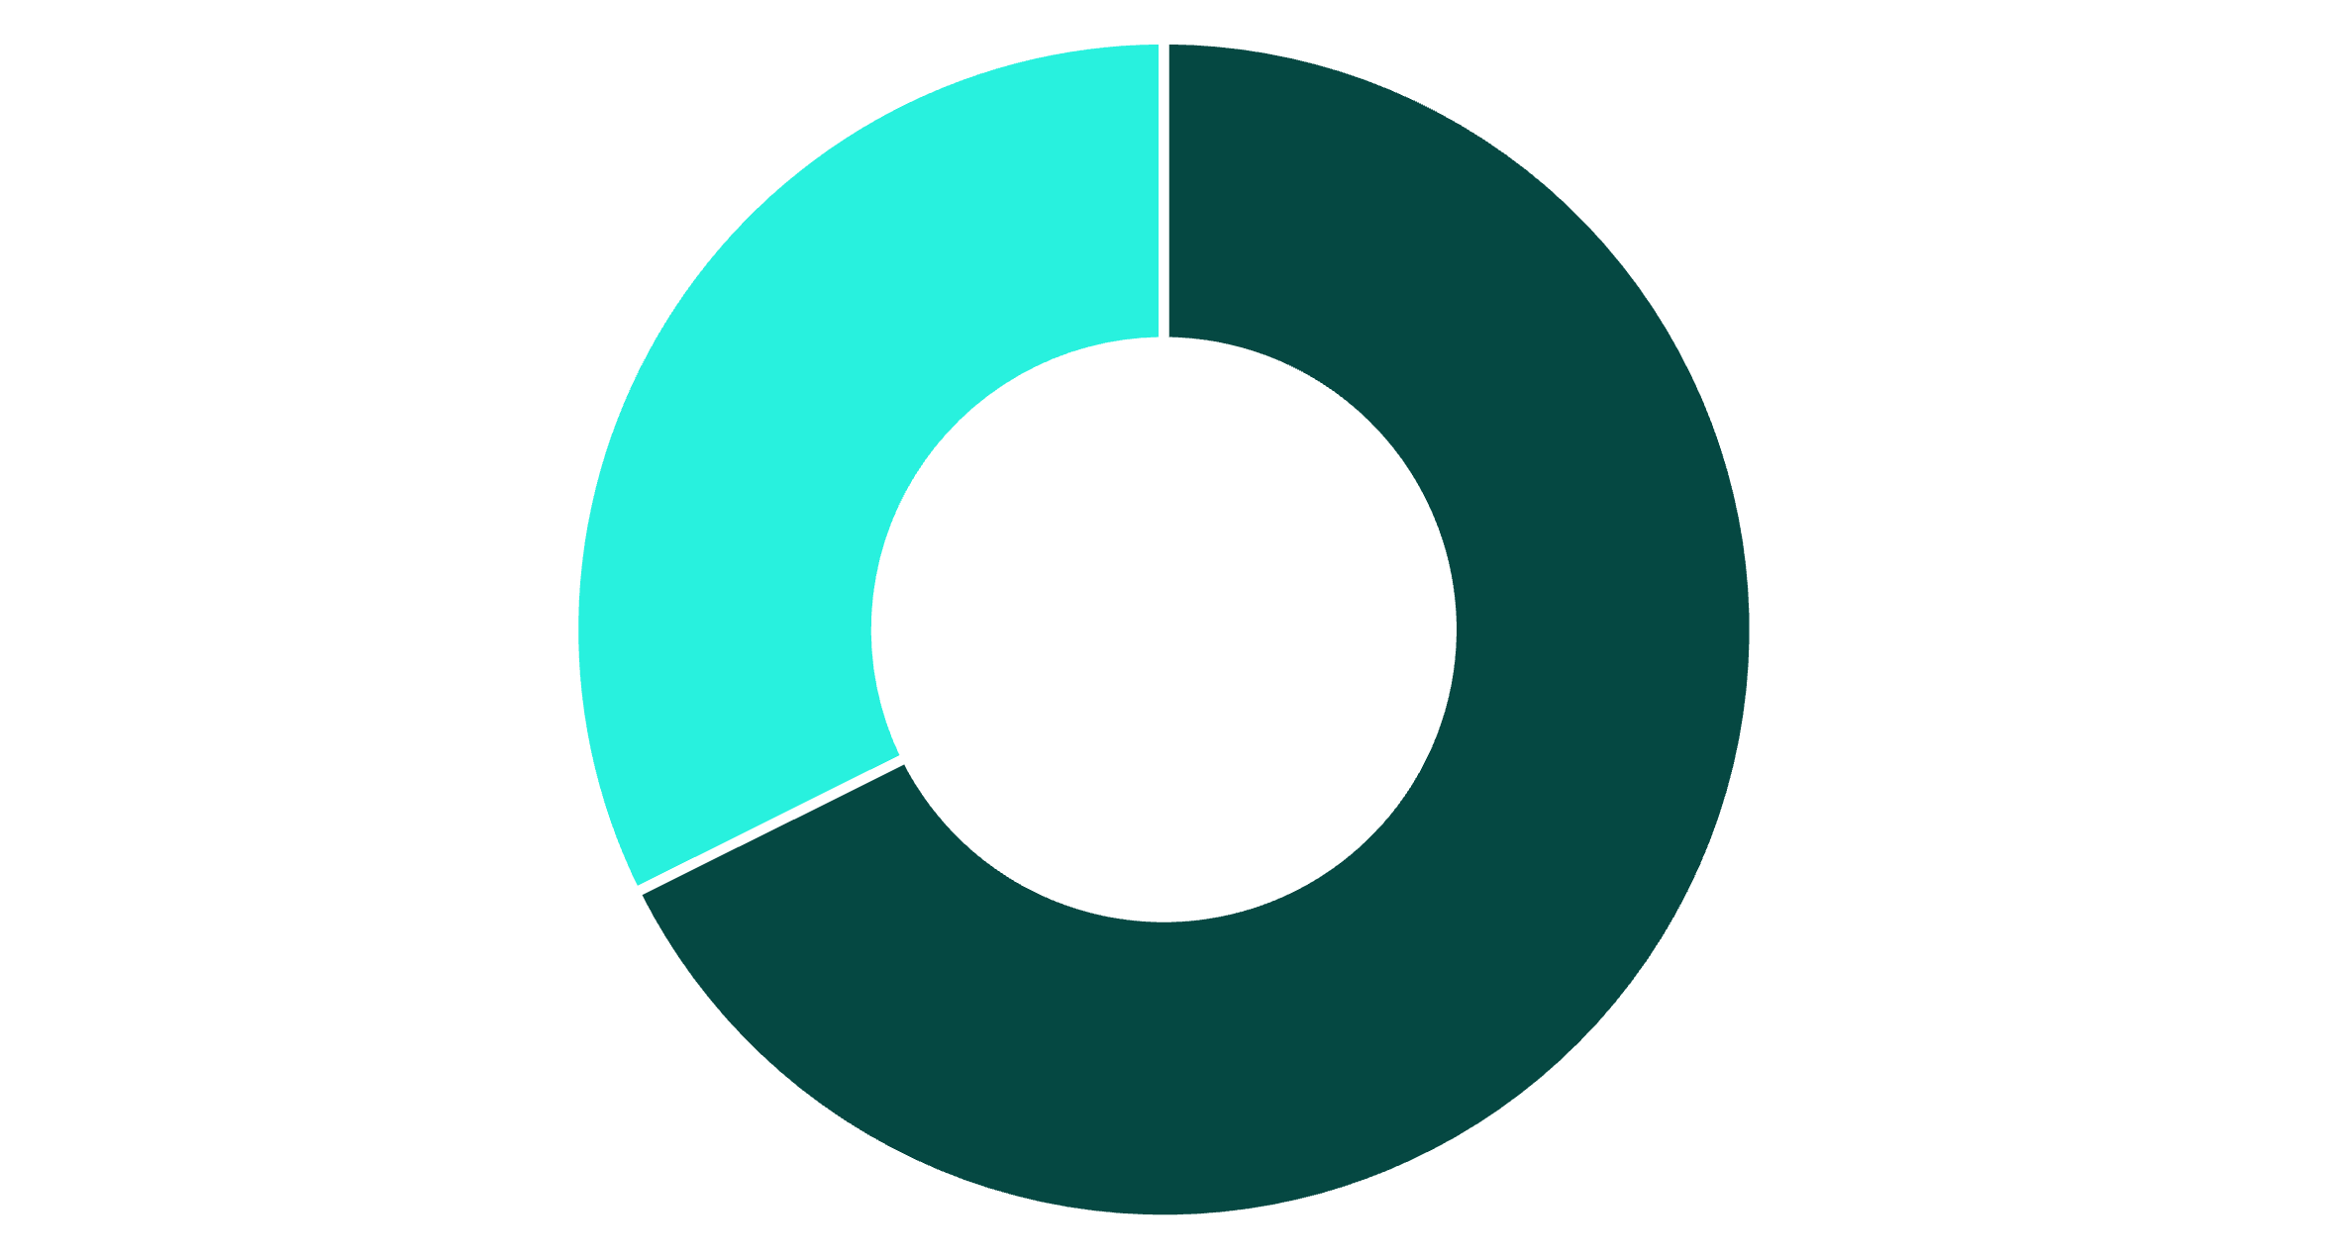
Revenue Insights by Gender
Male
Female
Gender Revenue Split
Male customers generate 68% of total revenue, significantly outpacing female customers at 32%.
This 2:1 ratio suggests opportunities for targeted marketing campaigns to balance customer engagement.
$158K
$75K
Male Revenue
Female Revenue

Slide 5




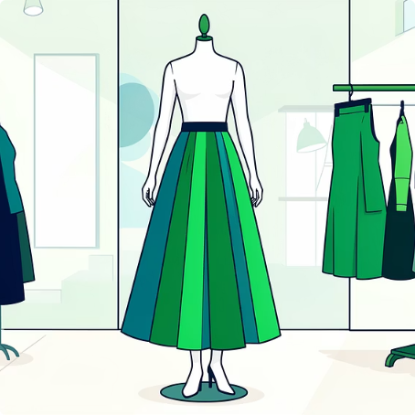
TOP PERFORMERS
Product Excellence
Gloves
Sandals
Boots
Hat
Rating: 3.86
Rating: 3.84
Rating: 3.82
Rating: 3.80
Skirt
Rating: 3.78
These top-rated products should be featured prominently in marketing campaigns and seasonal promotions.

Slide 6
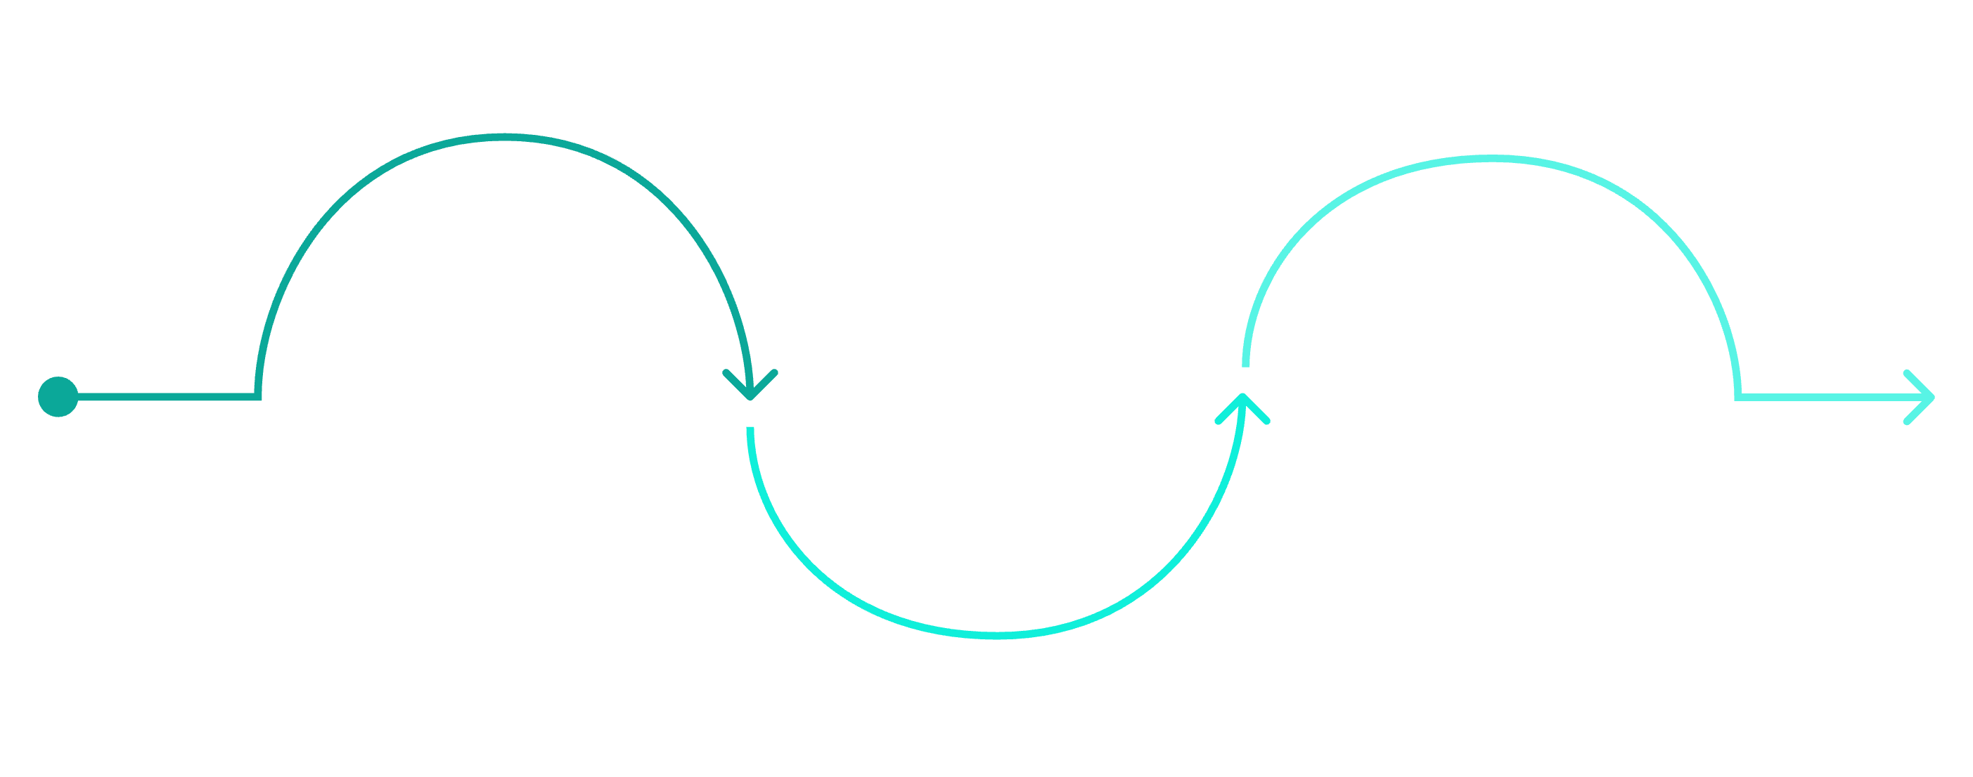
Customer Segmentation
New
Loyal
83 customers — acquisition focus
3,116 customers — retention strong
Returning
701 customers — conversion priority
Customer loyalty analysis reveals 80% are loyal customers, indicating strong retention but limited new customer acquisition.
Segment Breakdown
3.1K
701
83
Loyal
Returning
New
Focus on converting returning customers to loyal status while expanding new customer acquisition efforts.

Slide 7
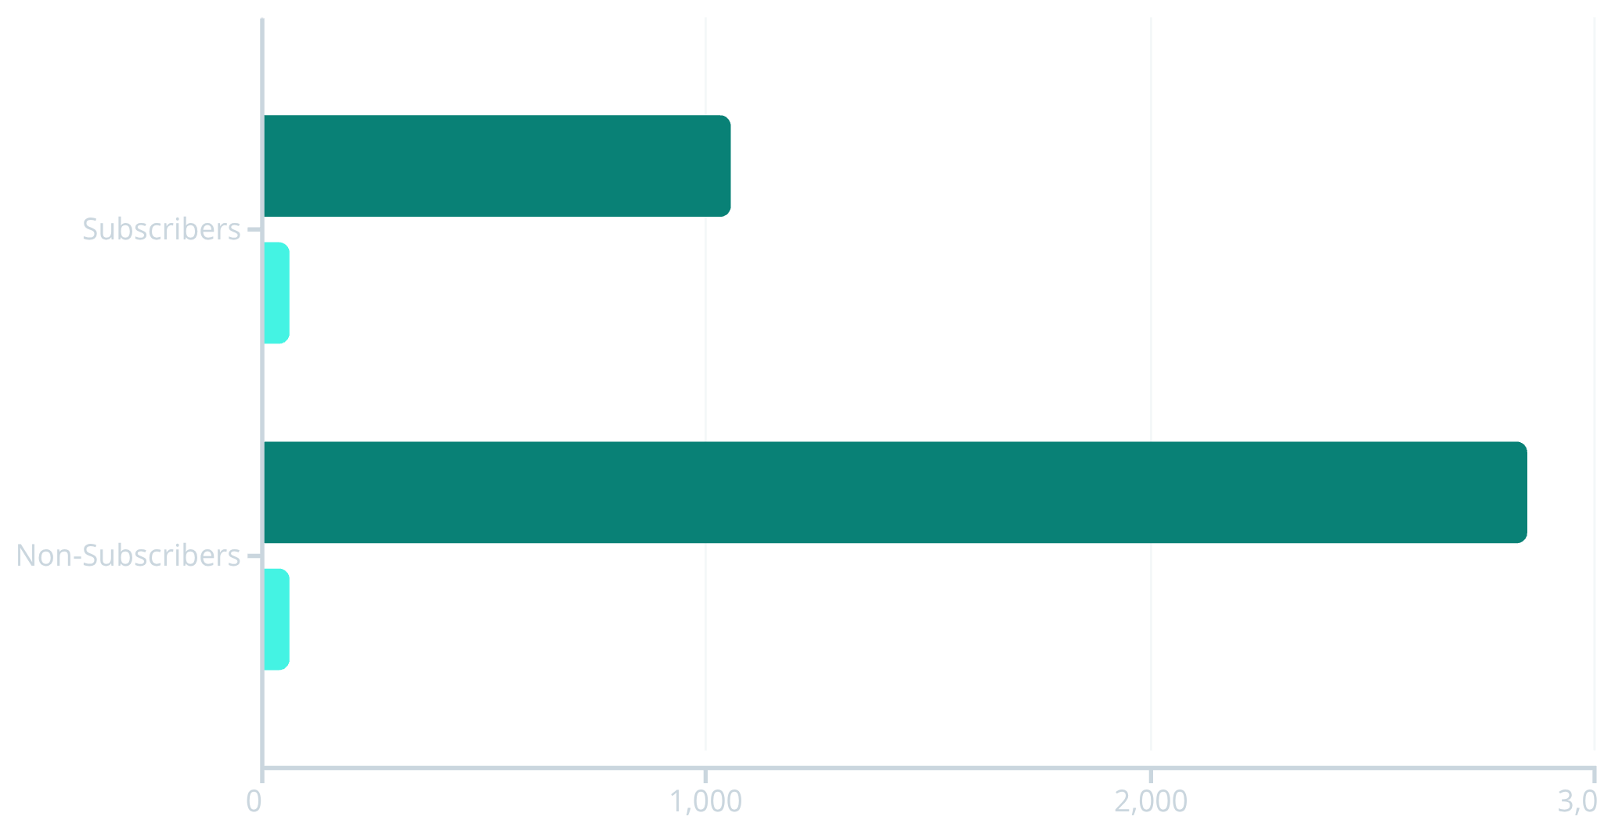


Subscription & Spending Patterns
Customers
Avg Spend
Subscription Opportunity
27%
73%
Subscribers
Non-Subscribers
Despite similar spending patterns, only 27% are subscribers. Huge growth potential exists in converting non-subscribers.
Subscribers generate $62.6K vs. $170.4K from non-subscribers—untapped revenue opportunity.

Slide 8
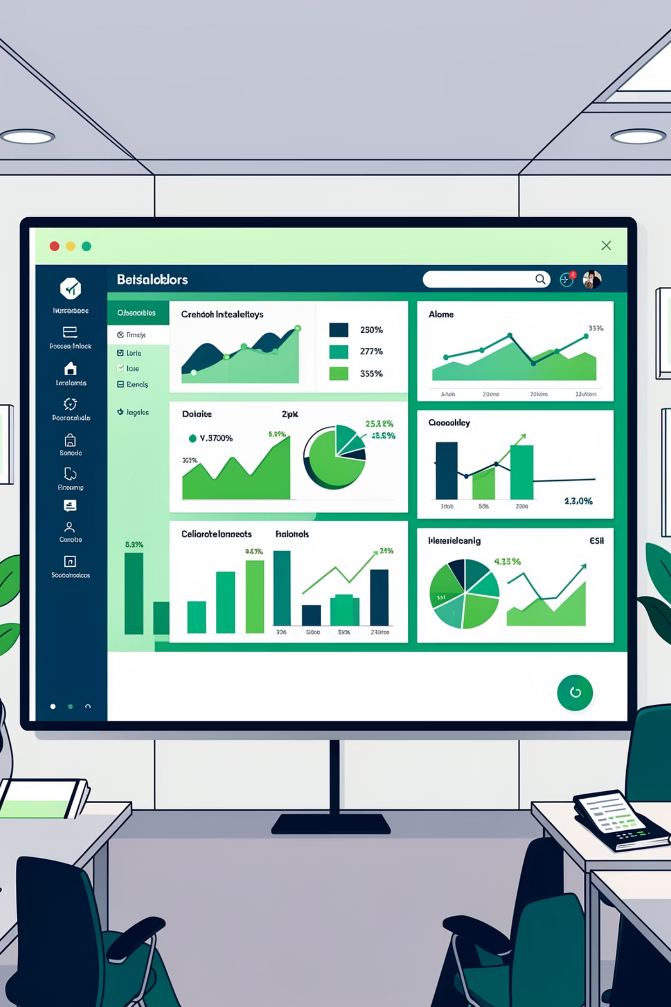
Power BI Dashboard
Real-Time Insights
Key Metrics
Visual Analysis
Interactive filters for subscription, gender, category, and shipping
3.9K customers, $59.76 avg purchase, 3.75 avg rating
Sales by category, revenue trends, age group distribution

Slide 9
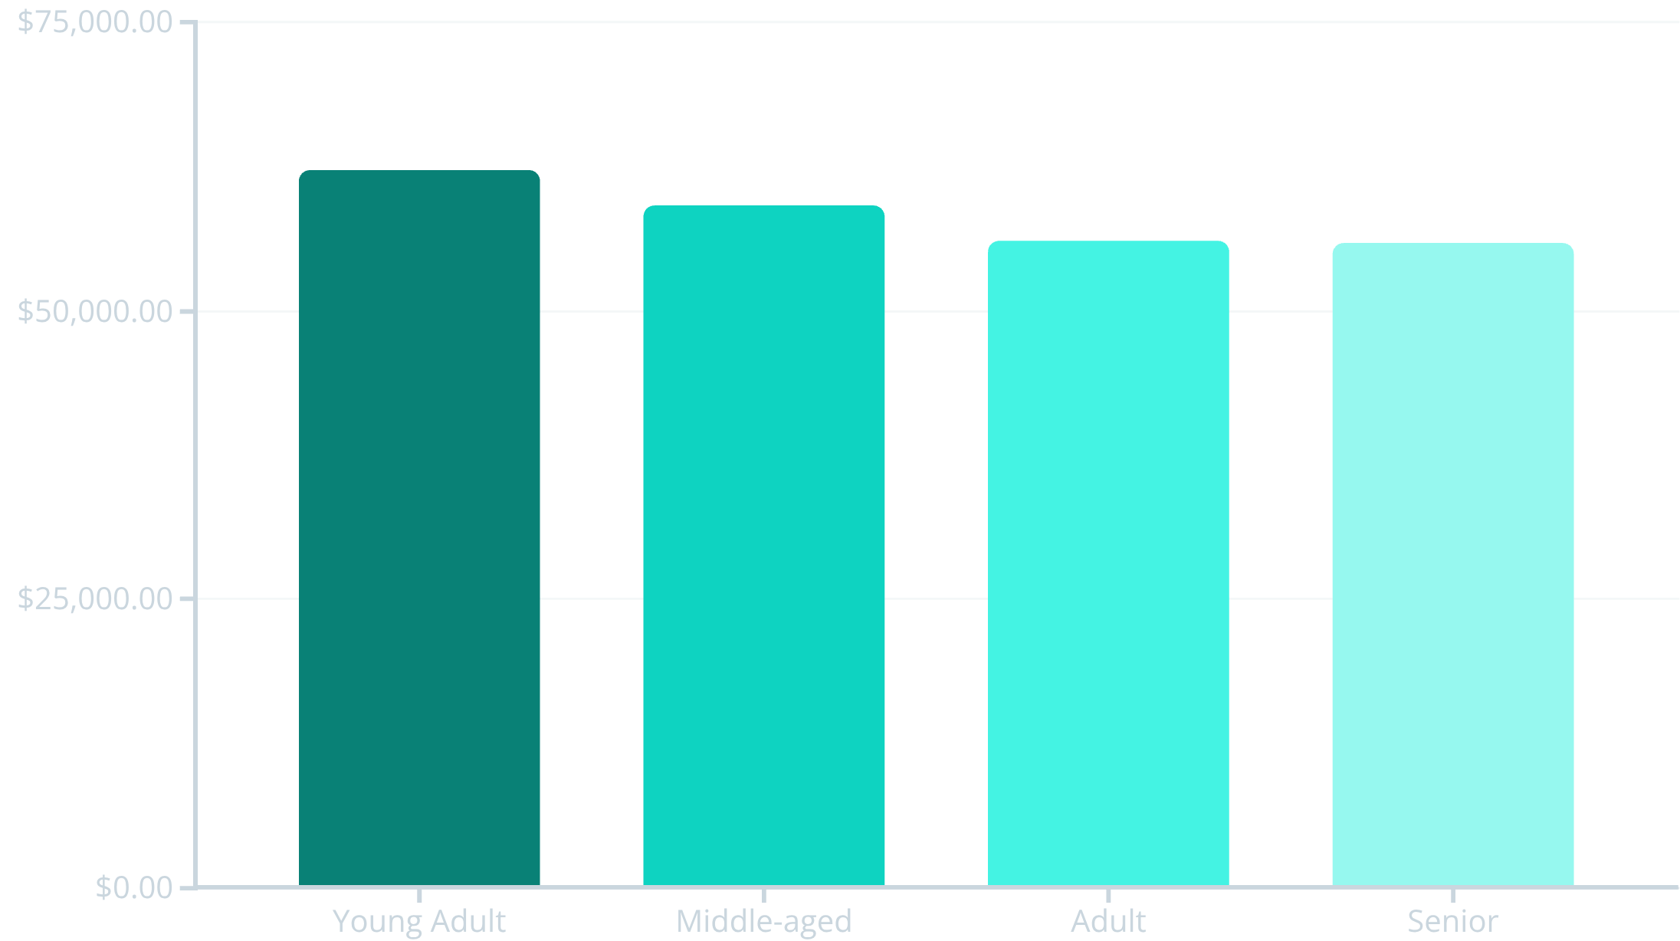
STRATEGIC INSIGHTS
Revenue by Age & Category
Age Group Performance
Category Leaders
Clothing dominates with 1,737 purchases, followed by Footwear and Accessories.
Young Adults drive highest revenue at $62K
Relatively balanced across age groups
Express shipping users show higher spend
Target marketing to Young Adults and express-shipping customers for maximum ROI.

Slide 10
ACTION PLAN
Business Recommendations
Boost Subscriptions
1
Promote exclusive benefits to convert 73% non-subscribers—massive revenue opportunity
Loyalty Programs
2
Reward repeat buyers to accelerate movement from Returning to Loyal segment
Review Discount Policy
3
839 high-spenders used discounts—balance sales boosts with margin control
Product Positioning
4
Feature top-rated items (Gloves, Sandals, Boots) in campaigns and seasonal promotions
Targeted Marketing
5
Focus on Young Adults and express-shipping users for highest revenue impact

